Slide 1
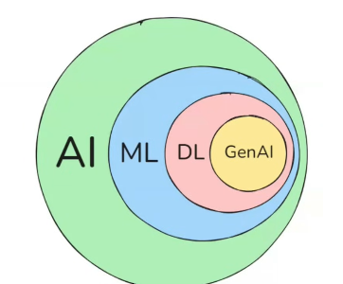

π
Basic Terminologies & Text Processing
July 2025
π

Slide 2
π
Index
Text Cleaning | Text Tokenization | Text Normalization
POS Tagging and Named Entity Recognition
Word Embedding
One Hot Encoding
Bag Of Word
TF-IDF
Word2Vec
Notes:
Content: https://www.linkedin.com/pulse/chunking-strategies-ai-data-kash-kashyap-0lghe/

Slide 3
π
Tokenization
Tokenization is a process of braking down text into manageable unit called tokens
Tokenization divides text into smaller units such words ,subwords or character .which are basic element for processing by an llm
when llm receive the prompt form he user ,the llm tokenizes convert text into user prompt into tokens.
The LLM then processes these input tokens and generates a response in the form of output token. The LLM tokenizes then converts the output tokens back into text that the user can understand.
tokens are typically represent numbers.
Notes:
Content: https://www.linkedin.com/pulse/chunking-strategies-ai-data-kash-kashyap-0lghe/

Slide 4
π
Tokenization Example
Text conversion to tokens
San Mateo Point to the Mexican border out 60 nm. A small chance of thunderstorms will continue through early this evening with scattered showers expected.
word can be converted into one or more tokens in
Let's walk through a simple example using sub word tokenization strategy, a word can be converted into one or more tokens. In a typical sub word tokenizes in English, 100 words might be broken down to approximately 100 and 30 tokens. Different languages will differ in their ratio of words to token.
Once the LLM tokenizer derives the tokens and then uses them to construct a vector. In this example, you can think of a vector as an array of integers. The LLM processes this vector to generate a response.
[ 24661, 44670, 5162, 315, 37943, 364, 22349, 99045, 33456, 789022 ]
Notes:
Content: https://www.linkedin.com/pulse/chunking-strategies-ai-data-kash-kashyap-0lghe/

Slide 5
π
For cloud-based llms where you have a pay for use pricing model, tokens have added importance
For these cloud-based llm, price iss based on the input tokens consume as well as the LLM output tokens produced.
Notes:
Content: https://www.linkedin.com/pulse/chunking-strategies-ai-data-kash-kashyap-0lghe/

Slide 6
π
Stop word
Notes:
Content: https://www.linkedin.com/pulse/chunking-strategies-ai-data-kash-kashyap-0lghe/

Slide 7
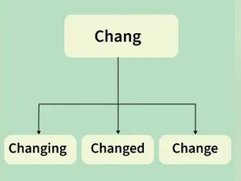
π
Stemming
Stemming in Natural Language Processing (NLP) is the process of reducing words to their root or base form, often by removing suffixes.
it helps us to simplify text for analysis by grouping similar word together
Original Word | Stemmed Word
running | run
better | bet
cats | cat
studies | studi
Sabji analogy – spinach( palak ), fenugreek( methi )
Notes:
Content: https://www.linkedin.com/pulse/chunking-strategies-ai-data-kash-kashyap-0lghe/

Slide 8

π
Over stemming
Under stemming
Notes:
Content: https://www.linkedin.com/pulse/chunking-strategies-ai-data-kash-kashyap-0lghe/

Slide 9
π
Lemmatization
Stemming in Natural Language Processing (NLP) is the process of reducing words to their root or base form, often by removing suffixes.
it helps us to simplify text for analysis by grouping similar word together
Original Word | Stemmed Word
running | run
better | bet
cats | cat
studies | studi
Sabji analogy – spinach( palak ), fenugreek( methi )
Notes:
Content: https://www.linkedin.com/pulse/chunking-strategies-ai-data-kash-kashyap-0lghe/

Slide 10
π
Notes:
Content: https://www.linkedin.com/pulse/chunking-strategies-ai-data-kash-kashyap-0lghe/

Slide 11
π
Notes:
Content: https://www.linkedin.com/pulse/chunking-strategies-ai-data-kash-kashyap-0lghe/

Slide 12
π
Tokenization
Tokenization is a process of braking down text into manageable unit called tokens
Tokenization divides text into smaller units such words ,subwords or character .which are basic element for processing by an llm
when llm receive the prompt form he user ,the llm tokenizes convert text into user prompt into tokens.
The LLM then processes these input tokens and generates a response in the form of output token. The LLM tokenizes then converts the output tokens back into text that the user can understand.
tokens are typically represent numbers.
Notes:
Content: https://www.linkedin.com/pulse/chunking-strategies-ai-data-kash-kashyap-0lghe/

Slide 13
π
Tokenization Example
Text conversion to tokens
San Mateo Point to the Mexican border out 60 nm. A small chance of thunderstorms will continue through early this evening with scattered showers expected.
word can be converted into one or more tokens in
Let's walk through a simple example using sub word tokenization strategy, a word can be converted into one or more tokens. In a typical sub word tokenizes in English, 100 words might be broken down to approximately 100 and 30 tokens. Different languages will differ in their ratio of words to token.
Once the LLM tokenizer derives the tokens and then uses them to construct a vector. In this example, you can think of a vector as an array of integers. The LLM processes this vector to generate a response.
[ 24661, 44670, 5162, 315, 37943, 364, 22349, 99045, 33456, 789022 ]
Notes:
Content: https://www.linkedin.com/pulse/chunking-strategies-ai-data-kash-kashyap-0lghe/

Slide 14
π
For cloud-based llms where you have a pay for use pricing model, tokens have added importance
For these cloud-based llm, price iss based on the input tokens consume as well as the LLM output tokens produced.
Notes:
Content: https://www.linkedin.com/pulse/chunking-strategies-ai-data-kash-kashyap-0lghe/

Slide 15
π
Key NLP Terminology
Corpus
A large collection of text documents used for training NLP models. It's essentially the dataset containing all the text that will be analyzed.
Document
A single piece of text within a corpus. It can be an article, a paragraph, or even a sentence, depending on how the data is structured.
Vocabulary
The set of all unique words present in the corpus. It's the dictionary terms that the model will learn from.
Token
Notes:
Content: https://www.linkedin.com/pulse/chunking-strategies-ai-data-kash-kashyap-0lghe/

Slide 16
π
Notes:
Content: https://www.linkedin.com/pulse/chunking-strategies-ai-data-kash-kashyap-0lghe/

Slide 17
π
1
Text Cleaning
Stop Words Removal : Eliminating common words that add little value to text
Punctuation Removal : Removing unnecessary punctuation marks from the text
Whitespace Removal : Removing extra spaces and tabs within the text
2
Text Tokenization
Word Tokenization : Splitting text into individual words.
Sentence Tokenization : Splitting text into sentences.
3
Text Normalization
Lowercasing : Converting all characters in the text to lowercase.
Stemming : Reducing words to their base or root form.
Lemmatization : Converting words to their dictionary form (lemma)
Text Segmentation : Breaking down a text into meaningful chunks
Notes:
Content: https://www.linkedin.com/pulse/chunking-strategies-ai-data-kash-kashyap-0lghe/

Slide 18
π
Notes:
Content: https://www.linkedin.com/pulse/chunking-strategies-ai-data-kash-kashyap-0lghe/

Slide 19
π
part
Text
Segment -> chunk
the process of dividing a continuous body of text into smaller, meaningful units called segments, such as words, sentences, paragraphs, or topics
Word, sentence
Notes:
Content: https://www.linkedin.com/pulse/chunking-strategies-ai-data-kash-kashyap-0lghe/

Slide 20
π
POS Tagging and Named Entity Recognition
Named Entity Recognition (NER) NLP component .the main purpose of it to recognize the entity that is nothing but a Important information
These entities can be
names of people,
places,
organizations,
Dates
“Sridhar want to buy Apple phone in India on January 5 2025”
Working
Approaches
Simple look up
Rule Based
machine learning
Text Pre-processing
Entity Identification
Entity Classification/Categorization
Contextual Analysis
Notes:
Content: https://www.linkedin.com/pulse/chunking-strategies-ai-data-kash-kashyap-0lghe/

Slide 21
π
Notes:
Content: https://www.linkedin.com/pulse/chunking-strategies-ai-data-kash-kashyap-0lghe/

Slide 22
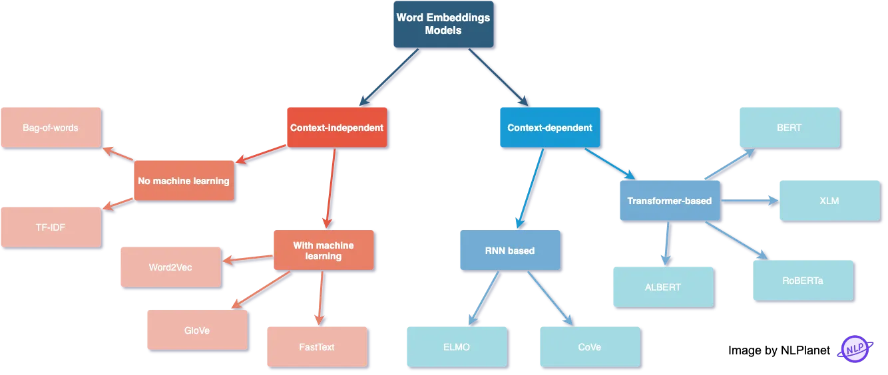
π
Word Embedding
converting our text into a numerical format, and for that, there are different methods
Notes:
Content: https://www.linkedin.com/pulse/chunking-strategies-ai-data-kash-kashyap-0lghe/

Slide 23
π
Word embedding
OHE
BOW
TF-IDF
Word2Vec
Notes:
Content: https://www.linkedin.com/pulse/chunking-strategies-ai-data-kash-kashyap-0lghe/

Slide 24
π
One hot encoding
One Hot Encoding is a technique for converting categorical data, like colors (red, green, blue), into numerical data
It creates new columns for each category where 1 means the category is present and 0 means it is not.
This allows machine learning algorithms to process the information in categorical data without misinterpreting any order between the categories.
Binary based encoding
For example, if we have a feature with three categories (A, B, and C), each category can be represented as a binary vector of length three, with the vector for category A being [1, 0, 0], the vector for category B being [0, 1, 0], and the vector for category C being [0, 0, 1].
Notes:
Content: https://www.linkedin.com/pulse/chunking-strategies-ai-data-kash-kashyap-0lghe/

Slide 25
π
“I love machine learning”
[1,0,0,0] - i
[0,1,0,0] - love
[0,0,1,0] - Machine
[0,0,0,1] - Learning
ex. - Red Blue Black
R - [1,0,0]
BL - [0,1,0]
BK - [0,0,1]
Notes:
Content: https://www.linkedin.com/pulse/chunking-strategies-ai-data-kash-kashyap-0lghe/

Slide 26
π
Why
Text
convert
Numeric
Disadvantage
High Dimensionality
High dimensionality describes datasets with a large number of features or variables, often exceeding the number of observations, leading to complexity and computational challenges
Sparsity
In database and data analysis ,this refers to a dataset where a large percentage of entries are empty or zero such as in a sparse matrix
Sparsity refers to a Matrix of numbers that includes many zeroes or values that will not significantly impact a calculation
No Semantic Meaning
Out of Vocabulary
In Natural Language Processing (NLP), Out-of-Vocabulary (OOV) words refer to any words a machine learning model has not encountered during its training phase. These words are not part of the model’s predefined vocabulary, which poses a significant challenge when processing text or speech that includes them. Since these models rely heavily on their learned vocabulary to make sense of input, encountering an OOV word can lead to errors or inaccuracies.
Notes:
Content: https://www.linkedin.com/pulse/chunking-strategies-ai-data-kash-kashyap-0lghe/

Slide 27
π
Bag Of Word
Corpus
The dog is happy. The child makes the dog happy. The dog makes the child happy
Bag of Words Model explanation
Corpus
A collection of text documents
Tokenize
D1: [The] [dog] [is] [happy]
D2: [The] [child] [makes] [the] [dog] [happy]
D3: [The dog] [makes] [the] [child] [happy]
Tokenize
Divide the text into smaller units called
tokens, usually words or phrases
Documents Counting word frequencies
D1 : the: 1, dog: 1, is: 1, happy: 1
D2 : the: 2, dog: 1, makes: 1, child: 1, happy: 1
D3 : the: 2, child: 1, makes: 1, dog: 1, happy: 1
Count word frequencies
Create a vocabulary of unique words and count the number of times each word appears in each document
Encode the data
Encoding the text data as numerical values by creating a vector for each document, with each element of the vector representing the frequency count of a particular word in the document
Encode | Child | dog | happy | is | makes | the | Bow vector representation
D1 | 0 | 1 | 1 | 1 | 0 | 1 | [0,1,1,1,0,1]
D2 | 1 | 1 | 1 | 0 | 1 | 2 | [1,1,1,0,1,2]
D3 | 1 | 1 | 1 | 0 | 1 | 2 | [1,1,1,0,1,2]
Notes:
Content: https://www.linkedin.com/pulse/chunking-strategies-ai-data-kash-kashyap-0lghe/

Slide 28
π
Bow turns text like sentence, paragraph or document into a collection of words and counts how frequently each word appears but ignoring the order of the words. It does not consider the order of the words or their grammar but focuses on counting how frequently each word appears in the text
Key Components of BoW
Vocabulary: It is a list of all unique words from the entire dataset. Each word in the vocabulary corresponds to a feature in the model
Document Representation: Each document is represented as a vector where each element shows the frequency of the words from the vocabulary in that document. The frequency of each word is used as a feature for the model.
Notes:
Content: https://www.linkedin.com/pulse/chunking-strategies-ai-data-kash-kashyap-0lghe/

Slide 29


π
TF-IDF
Term frequency
Inverse Document Frequency
evaluate how important a word. TF-IDF combines two components:
Term Frequency (TF):
TF measures the frequency of a term(word) within a document. It is calculated as the ratio of the number of times a term occurs in a document to the total number of terms in that document. The goal is to emphasize words that are frequent within a document.
Inverse Document Frequency (IDF):
Reduces the weight of common words across multiple documents while increasing the weight of rare words. If a term appears in fewer documents, it is more likely to be meaningful and specific.
Notes:
Content: https://www.linkedin.com/pulse/chunking-strategies-ai-data-kash-kashyap-0lghe/

Slide 30
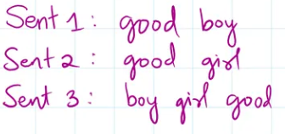
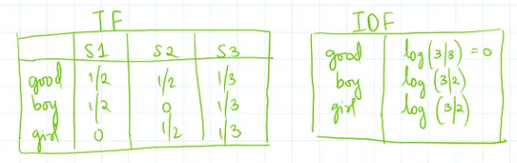
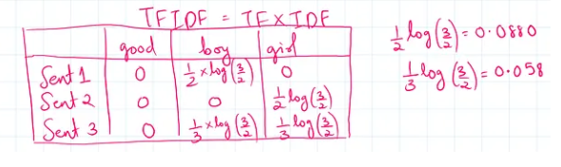
π
Notes:
Content: https://www.linkedin.com/pulse/chunking-strategies-ai-data-kash-kashyap-0lghe/

Slide 31
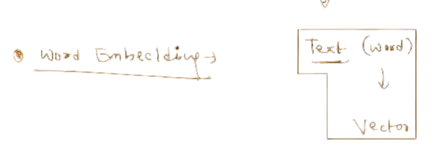
π
Word2Vec
The purpose of Word2Vec is to change words from text format into numerical vector format so that computers can understand and work with language data meaningfully.
* Struggle
One Hot Encoding | BOW | TF-IDF
Semantic Meaning
High Dimensionality
Notes:
Content: https://www.linkedin.com/pulse/chunking-strategies-ai-data-kash-kashyap-0lghe/

Slide 32
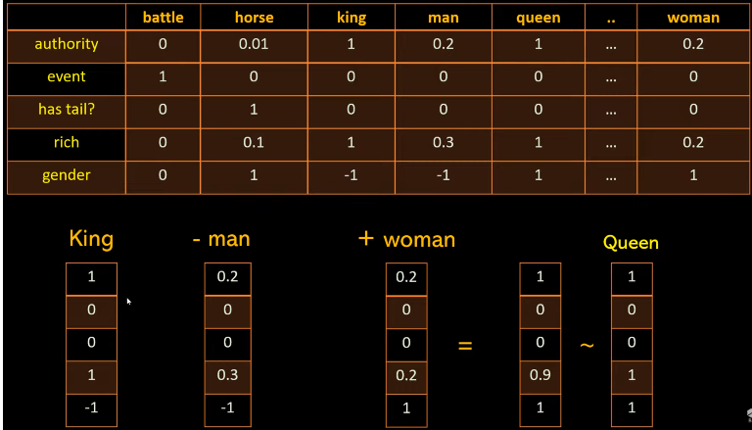
π
Notes:
Content: https://www.linkedin.com/pulse/chunking-strategies-ai-data-kash-kashyap-0lghe/

Slide 33
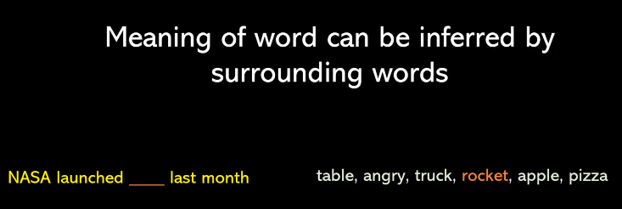
π
Surrounding word=Context
Notes:
Content: https://www.linkedin.com/pulse/chunking-strategies-ai-data-kash-kashyap-0lghe/

Slide 34
π
Notes:
Content: https://www.linkedin.com/pulse/chunking-strategies-ai-data-kash-kashyap-0lghe/

Slide 35
π
Clone….
Notes:
Content: https://www.linkedin.com/pulse/chunking-strategies-ai-data-kash-kashyap-0lghe/

Slide 36
π
Notes:
Content: https://www.linkedin.com/pulse/chunking-strategies-ai-data-kash-kashyap-0lghe/

Slide 37
π
Clone…………
Notes:
Content: https://www.linkedin.com/pulse/chunking-strategies-ai-data-kash-kashyap-0lghe/

Slide 38
π
Notes:
Content: https://www.linkedin.com/pulse/chunking-strategies-ai-data-kash-kashyap-0lghe/

